Slide 1
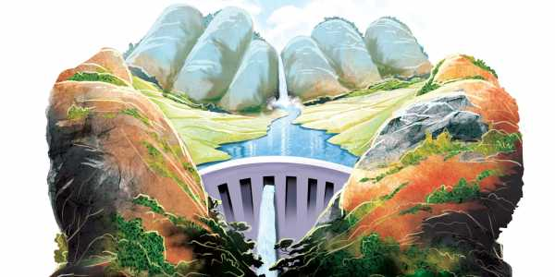
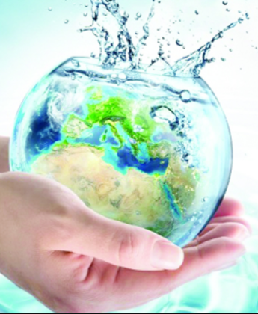
LECTURE – 2.1
Natural resources, Energy consumption & conservation
Part – I Water Resources

Slide 2
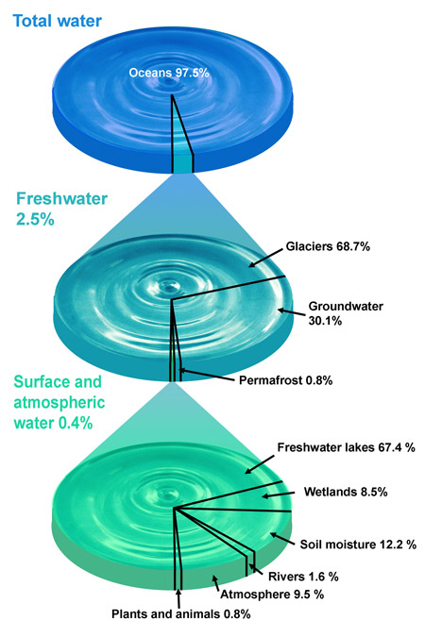
Distribution of water resources
About two-thirds of the earth’s surface is covered with water. The total amount of water on the earth is about 1400 million km³ (UNEP, 2002). Of this, around 97.5% by volume is held in the oceans and is salt water. Only 2.5% (or about 35 million km³) is fresh water.
9 countries are the world giants in terms of internal water resources, accounting for 60 percent of the world’s natural freshwater (Canada, Indonesia, Brazil, Russia, U.S., Colombia, India, China, Peru).
33 countries depend on other countries for over 50 percent of their renewable water resources: Argentina, Azerbaijan, Bahrain, Bangladesh, Benin, Bolivia, Botswana, Cambodia, Chad, Congo, Djibouti, Egypt, Eritrea, Gambia, Iraq, Israel, Kuwait, Latvia, Mauritania, Mozambique, Namibia, Netherlands, Niger, Pakistan, Paraguay, Portugal, Republic of Moldova, Romania, Senegal, Somalia, Sudan, Syrian arab republic, Turkmenistan, Ukraine, Uruguay, Uzbekistan, Vietnam and Yugoslavia.
https://www.e-education.psu.edu/earth103/node/701
http://www.fao.org/3/y4473e/y4473e08.htm

Slide 3
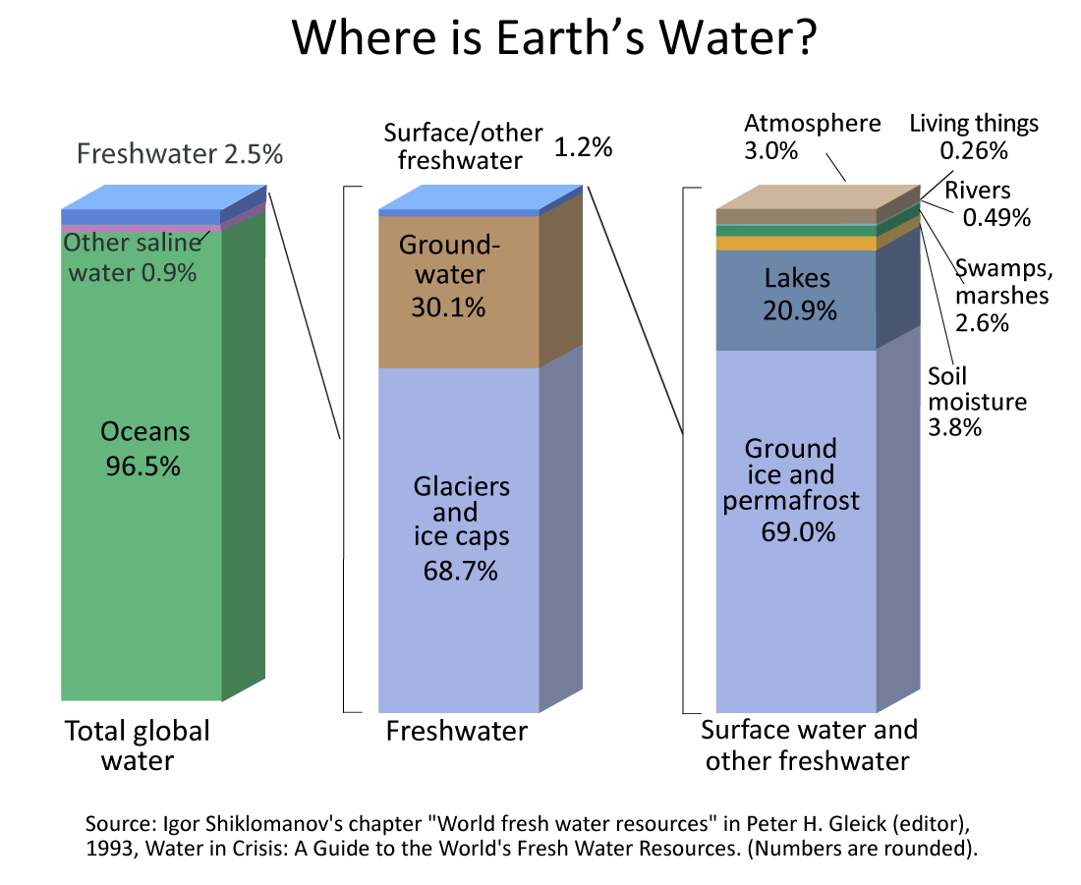

Slide 4
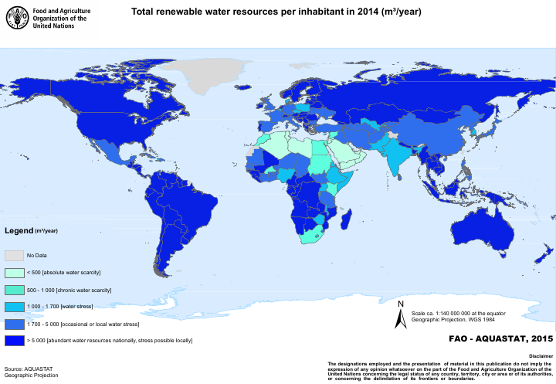

Slide 5
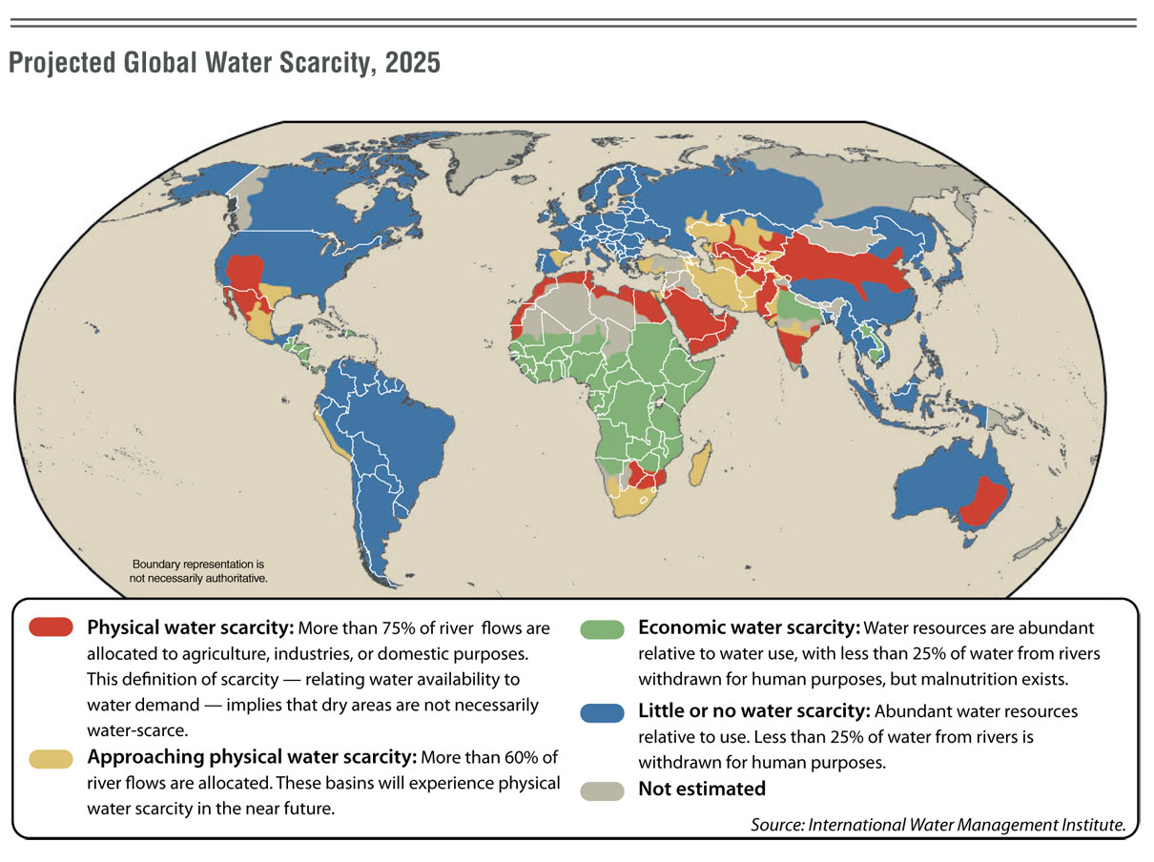
Of a population of roughly 6.1 billion, more than 1 billion lack access to potable water - The World Health Organization

Slide 6
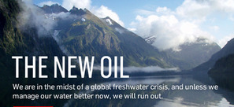
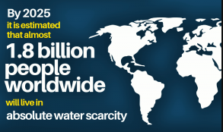
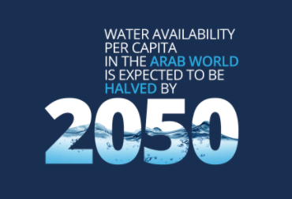
Statistics
Surface cover
Fresh water
Available water
Realistic
Population
Inefficient irrigation
Pollution
Water shortage
<1000 cu.m per person per year
Water crisis
<500 cu.m per person per year
Indian status
Year 1951 – 5177 cu.m
Year 2001 – 1820 cu.m
Water shortage situation by 2025?

Slide 7
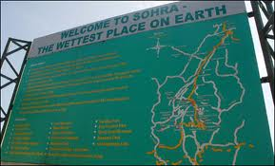
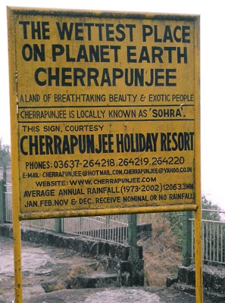
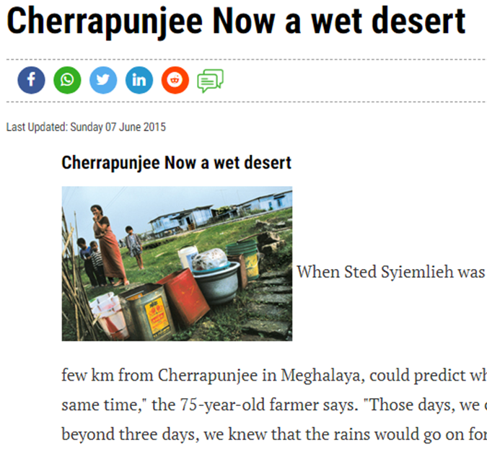
Case Study - India's wettest place 'lacks water’ - WHY???
Once the world's wettest places, cherrapunji is getting up to 20% less rain every year - and is suffering water shortages – BBC news
Climate change, population increase set off water shortages in what was once the wettest place on earth.
Water crisis hits ‘cherrapunji’ of meghalaya as rain continues to be elusive – the indian express - 2009
Major causes: deforestation, population growth, water supply and storage system mismanagement, reduced rainfall,
http://news.bbc.co.uk/2/hi/south_asia/8378327.stm#:~:text=Once%20the%20world's%20wettest%20places,blame%20it%20on%20global%20warming.

Slide 8
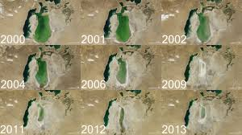
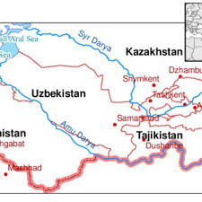
Case Study – Shrinkage of Aral Sea
In the 1960s, the soviet union undertook a major water diversion project on the arid plains of Kazakhstan, Uzbekistan, and Turkmenistan.
The, fed by snowmelt and precipitation in faraway mountains, were used to transform the deregion’s two major riverssert into farms for cotton and other crops.
Before the project, the Syr darya and the Amu darya rivers flowed down from the mountains, cut northwest through the kyzylkum desert, and finally pooled together in the lowest part of the basin.
The lake they made, the Aral sea, was once the fourth largest in the world.
Although irrigation made the desert bloom, it devastated the Aral Sea.
As the Aral Sea has dried up, fisheries and the communities that depended on them collapsed.
The increasingly salty water became polluted with fertilizer and pesticides. The blowing dust from the exposed lakebed, contaminated with agricultural chemicals, became a public health hazard. The salty dust blew off the lakebed and settled onto fields, degrading the soil.
In 2005, a World Bank‒funded dam and restoration project began in Kazakhstan with the goal of improving the health of the Syr Darya and increasing the flow into the North Aral Sea. Since then the water level has risen there and salinity has decreased.
https://earthobservatory.nasa.gov/world-of-change/AralSea

Slide 9
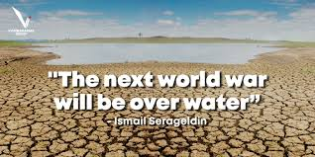

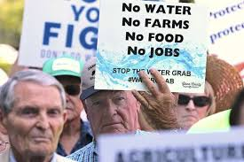
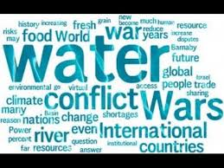
Water wars: early warning tool uses climate data to predict conflict hotspots
Tension over water scarcity is increasing across the globe. A new system flags up where this threatens to erupt into violence.
Water conflicts can occur on the intrastate and interstate levels.
Interstate conflicts occur between two or more neighboring countries that share a transboundary water source, such as a river, sea, or groundwater basin. For example, the Middle East has only 1% of the world's freshwater shared among 5% of the world's population
Intrastate conflicts take place between two or more parties in the same country. An example would be the conflicts between farmers and industry (agricultural vs industrial use of water).
According to UNESCO, the current interstate conflicts occur mainly in the Middle East (disputes stemming from the Euphrates and Tigris Rivers among Turkey, Syria, and Iraq; and the Jordan River conflict among Israel, Lebanon, Jordan and the State of Palestine), in Africa (Nile River-related conflicts among Egypt, Ethiopia, and Sudan), Central Asia (the Aral Sea conflict among Kazakhstan, Uzbekistan, Turkmenistan, Tajikistan and Kyrgyzstan).
In 1948, India and Pakistan had a dispute over the sharing of water rights to the Indus River and its tributaries – Indus water treaty
http://www.unesco.org/new/en/natural-sciences/resources/periodical/a-world-of-science/vol-11-n-1/in-focus-water-cooperation/water-wars/

Slide 10
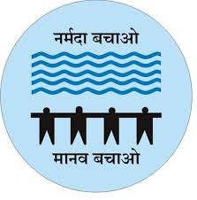

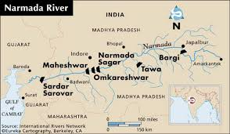
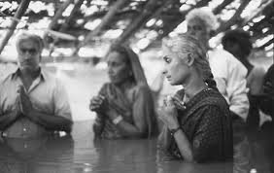
Irrigation Project - Narmada River Development
List of Major Dams in Narmada River Valley:
Sardar Sarovar Dam
Indira Sagar Dam
Omkareshwar Dam
Maheshwar Dam
Bargi Dam
Maan Dam
Jobat Dam
Tawa Dam
Narmada Canal
Narmada River is one of the longest river in Indian subcontinent, flows entirely within India. It originates from small kund known as Narmada Kund in Amarkantak and draining through the Gulf of Khambhat into the Arabian Sea, near the Bharuch city of Gujarat.
The Sardar Sarovar Project is one of the largest water resources project of India covering four major states - Maharashtra, Madhya Pradesh, Gujarat and Rajasthan. Dam's spillway discharging capacity (30.7 lakhs cusecs) would be third highest in the world.
the Narmada Main Canal would be the largest irrigation canal in the world.
The dam’s foundation stone was laid by Jawaharlal Nehru in 1961 and since 1979 when it became operational, it has irrigated large parts of water starved regions of Kutch and Saurashtra.
https://sardarsarovardam.org/project.aspx

Slide 11

THE NARMADA ISSUE
The Narmada valley project (NVP) is made up of plans for 30 major, 136 medium and 3,000 minor dams in India.
In Sardar Sarovar project (SSP) in the state of Gujarat and the Narmada sagar project (NSP) in the state of Madhya Pradesh are, at present, the NVPs major constituents.
These projects had been treading water for many years for want of environmental clearance from the Ministry of Environment and Forests. The Indian government eventually gave clearance for the construction of the SSP in Gujarat and the NSP in Madhya Pradesh.
Both environmentalists and social activists have raised serious questions about the projects.
Narmada Bachao Andolan (NBA) is an Indian social movement spearheaded by native tribals, farmers, environmentalists and human rights activists against a number of large dam projects across river Narmada.
The controversy has been accentuated by repeated increases in the dam’s height, since it became operational. Ever since 1999, the dam’s height has been raised progressively over the years, from the initial 80m to 138.68m.
Later, Supreme Court allowed the height to be raised from the present 121.92m to 138.68m.
Out of the controversy, there are two basic issues that have been raised by those opposing the project:
Inadequate rehabilitation measures for displaced persons.
Lack of optimum utilization of existing water due to incomplete water distribution infrastructure.
http://www.walkthroughindia.com/walkthroughs/large-dams-and-canal-of-the-narmada-river-valley-project/

Slide 12
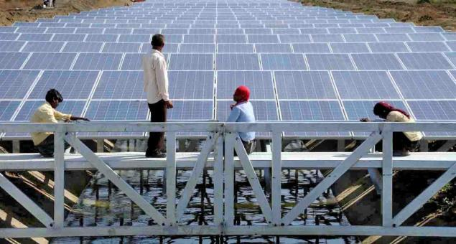
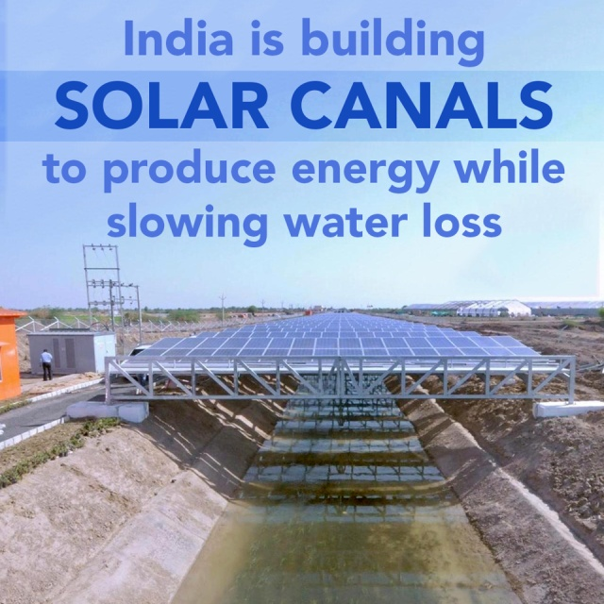
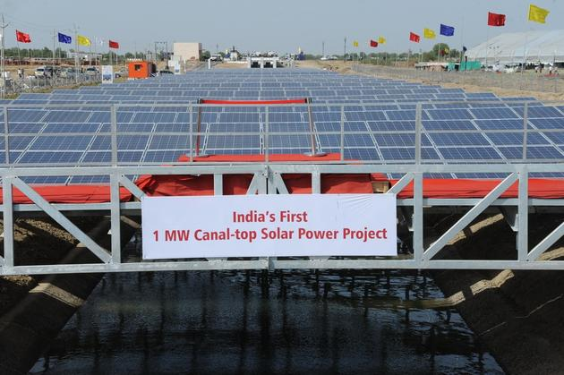
March, 12, 2013
Reduce evaporation of the canal water by an estimated 237,750 gallons of water each year
The pilot project has been developed on a 750-m stretch of the canal by Gujarat state electricity corporation (GSECL) with support from Sardar Sarovar Narmada Nigam ltd (SSNNL)
UN secretary-general ban ki-moon - inaugurated a 10 MW canal top solar power plant in Vadodara (Jan 13, 2015) on the sidelines of the vibrant Gujarat summit.
3.6-kilometre stretch of canal
Consists of 33,816 solar photovoltaic panels
Expected to generate 16.2 million units of electricity for the first year

Slide 13
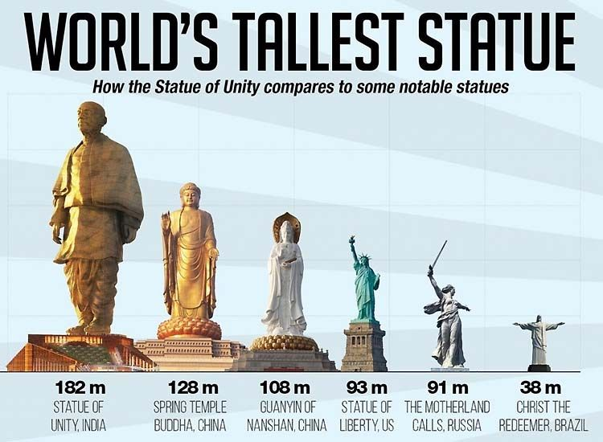
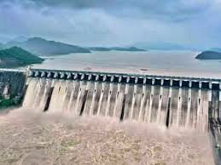

Slide 14
Sustainable Water Management
general
Re-directing excess water
Desalination: more than 7,500 desalination plants operating in the world, 4,500 in the Middle East alone
.Preventing leakage from municipal pipes
Pricing water –responsible use
Rain water harvesting
Collection from atmosphere
Treatment of water
Irrigation
Covered canals
Drip Irrigation
Precise irrigation:
Soil management
Dams
Building several small reservoirs.
2. Small catchment areas& protecting the wetlands
3. Preventing leakage from dams, canals and municipal pipes
4. In deforested areas-soil management by bunds and nalla plugs.

Slide 15
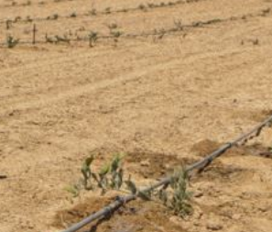
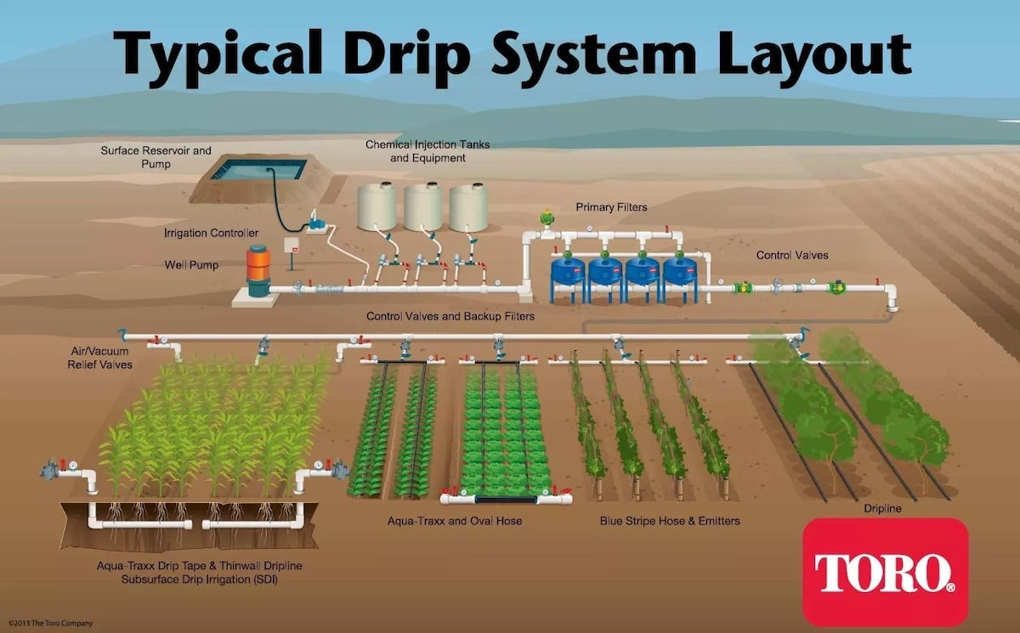
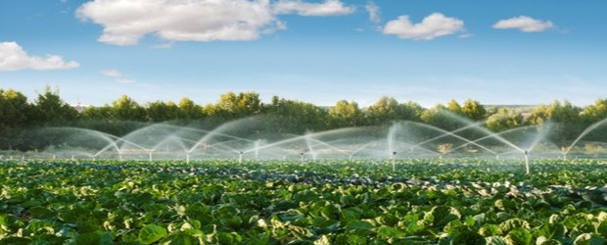
Precision irrigation / Drip irrigation
https://www.netafim.com/en/precision-Irrigation/
https://www.legit.ng/1100106-irrigation-farming-nigeria.html
WATCH VIDEO: https://youtu.be/1C1yhGfdnAU
https://india.smartcitiescouncil.com/article/precision-irrigation-improving-crop-water-management-telangana-varsity-make-it-possible

Slide 16
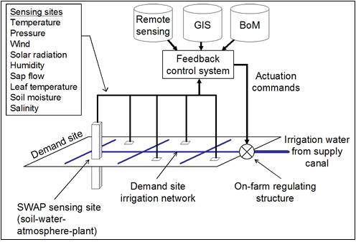
Expansion of Drip Irrigation with New Sensors, Monitors, Controls Could Add to Water and Nutrient Delivery Savings

Slide 17
Micro / Drip irrigation in India
Area covered - about 5 lakh hectares.
Maharashtra - Leading state
Followed by - Karnataka, Andhra Pradesh and Tamil Nadu.
Popular in 30 different crops especially in wide spaced horticultural crops.
Significant water saving - 25 and 50% by drip irrigation as compared with surface irrigation
Yield increases as high as 100% in some crops under specific locations.

Slide 18
Questions
WHY DO YOU THINK INSPITE OF HAVING SO MUCH AMOUNT OF WATER ON EARTH WATER IS NOT AVAILABLE FOR EACH AND EVERYONE ON THIS EARTH?
Discuss the case study of aral sea explaining the fact that how short term goals can be disastrous.
Discuss 5 methods of sustainable water management with special emphasis on agriculture.
Explain how solar canal can have two kind of benefits if installed above the water canal?

